Slide 1
A Pre-Training Based Personalized
Dialogue Generation Model with
Persona-sparse Data
AAAI 2020
汇报人：冯雅茹

Slide 2
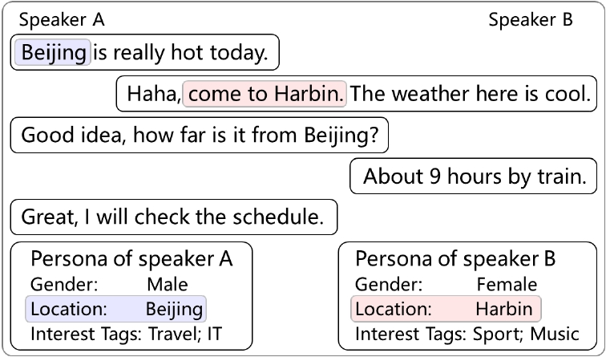
Open-domain Dialogues are Persona-sparse
Persona related
Persona related
Non-persona related
Non-persona related
Non-persona related
An example dialogue sampled from the PersonalDialog dataset

Slide 3
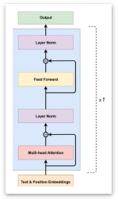
Problems When Using Persona-dense Data
I need to
exhibit my
persona
ASAP
I need to
exhibit my
persona
ASAP
Nice to
meet you
Fine-tune with
PERSONA-
CHAT
Pre-trained
GPT
How PERSONA-CHAT is
collected
Direct fine-tuning lead to in-coherent responses

Slide 4
Our Contribution
• A pre-training-based dialogue model that can utilize persona-
sparse dialogue data
• An attention routing mechanism to control the amount of
persona-related features to exhibit in the response
4

Slide 5
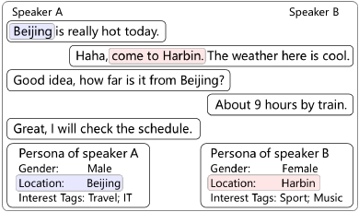
Task Formulization
Inputs:
• Post C
• Responder's persona profile 𝑇:
<k₁,v₁> , <k₂,v₂> ,... <k_{N},v_{N}>
Output:
• Response 𝑌, such that
5

Slide 6
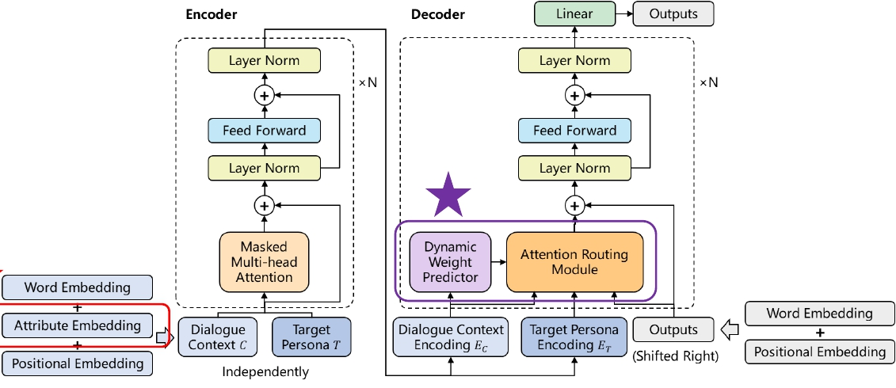
Model: Overview
2
1
7

Slide 7
Model: Attribute Embedding
The input representation of the dialogue context
The input embedding for each token is the sum of
1. A word embedding
2. A positional embedding
3. Attribute embeddings (Gender embeddings, Location embeddings, Tag embeddings)
8

Slide 8
Model: Overview
2
1
6

Slide 9
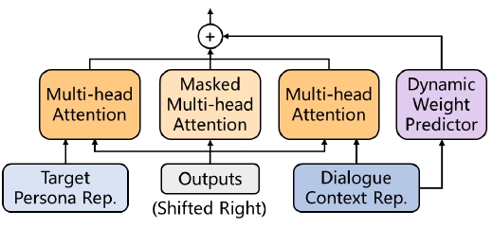
Model: Attention Routing
Dynamic Weight predictor
Attention Routes
Query Key Value
E_{T} E_{prev} E_{C}
The weight predictor and three attention routes

Slide 10
Model: Loss and Training
Loss:
Training:
•
•
The encoder and decoder share a same set of parameters
Parameters are initialized using a pretrained GPT model
12

Slide 11
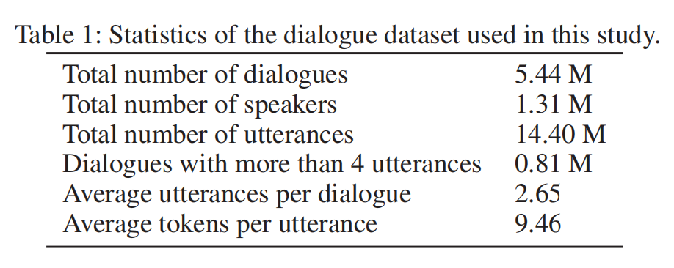
Dataset: PersonalDialog
1. Three persona attributes were approached (“Gender”, “Location”, and “Interest Tags”)
2. Two test sets are used: random test set and biased test set
13

Slide 12
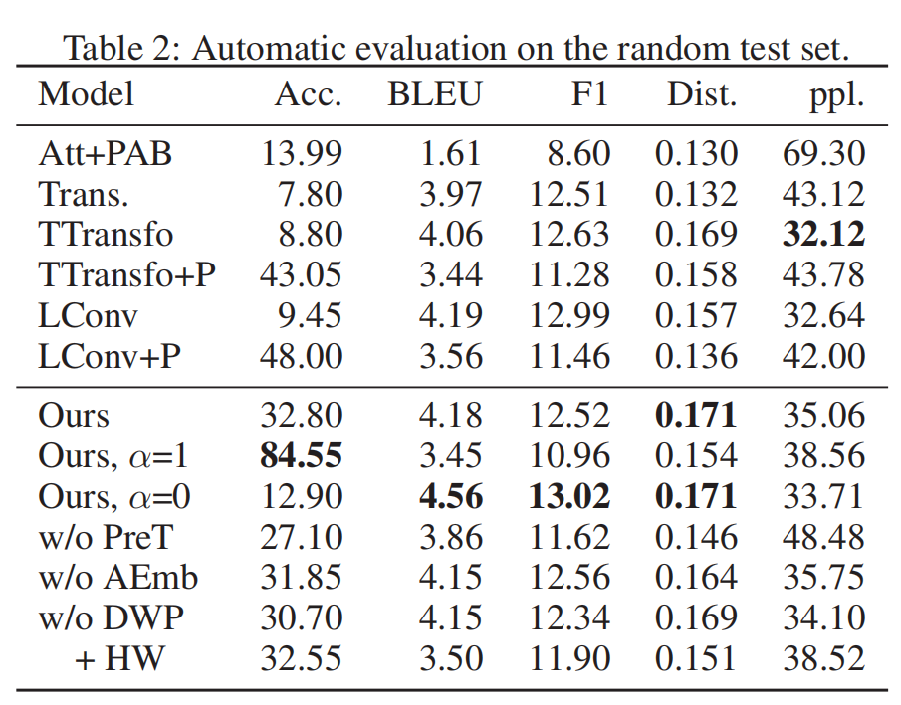
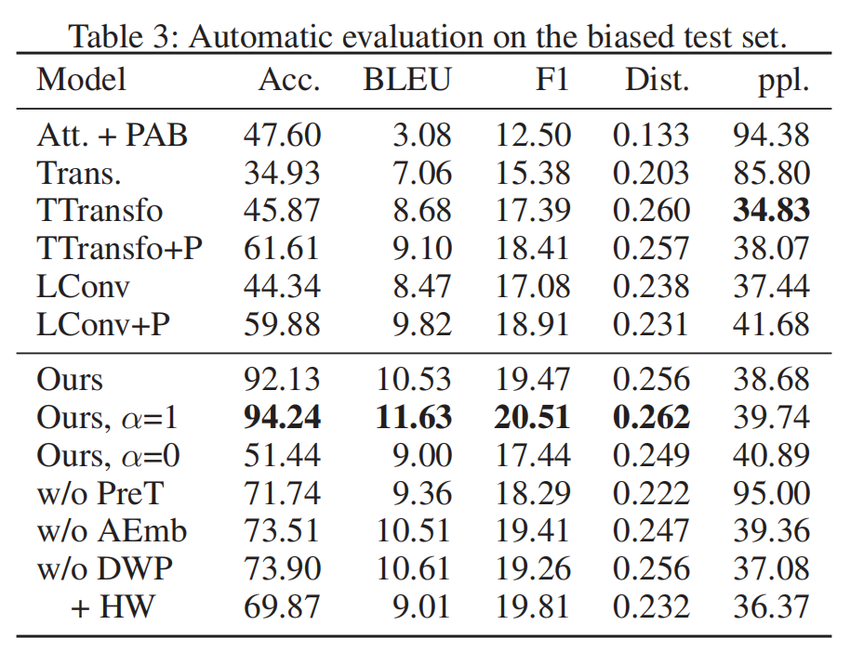
Automatic Evaluation
Metric:
(1) Persona Accuracy, (2) BLEU, (3) F1, (4) Distinct

Slide 13
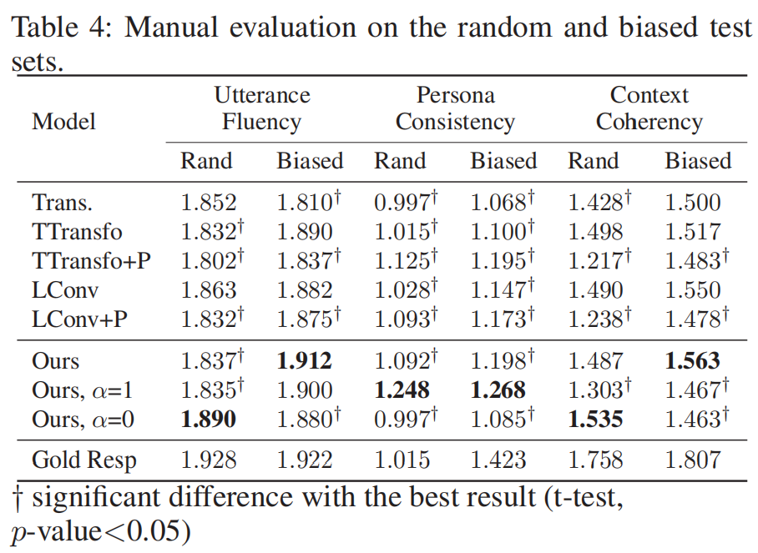
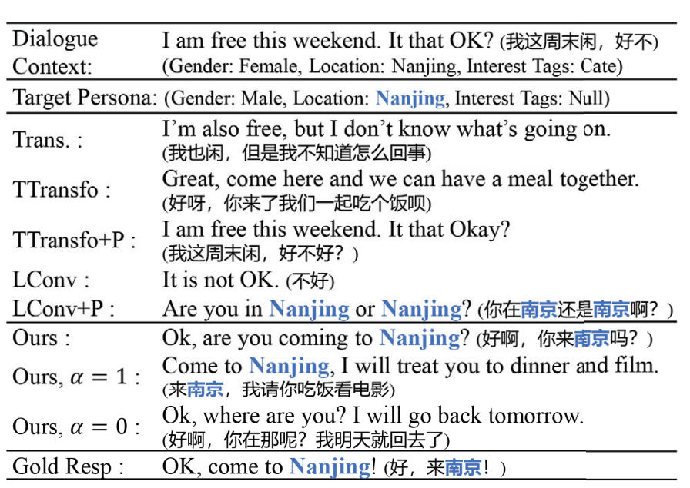
Manual Evaluation
Metric:
(1) Utterance Fluency, (2) Persona Consistency, (3) Context Coherency

Slide 14
Conclusion
• Our model can produce coherent and persona-consistent responses
• The dynamic routing mechanism helps to utilize persona-sparse dialogues
• There are trade-offs between persona consistency and context coherency
16

